Slide 1
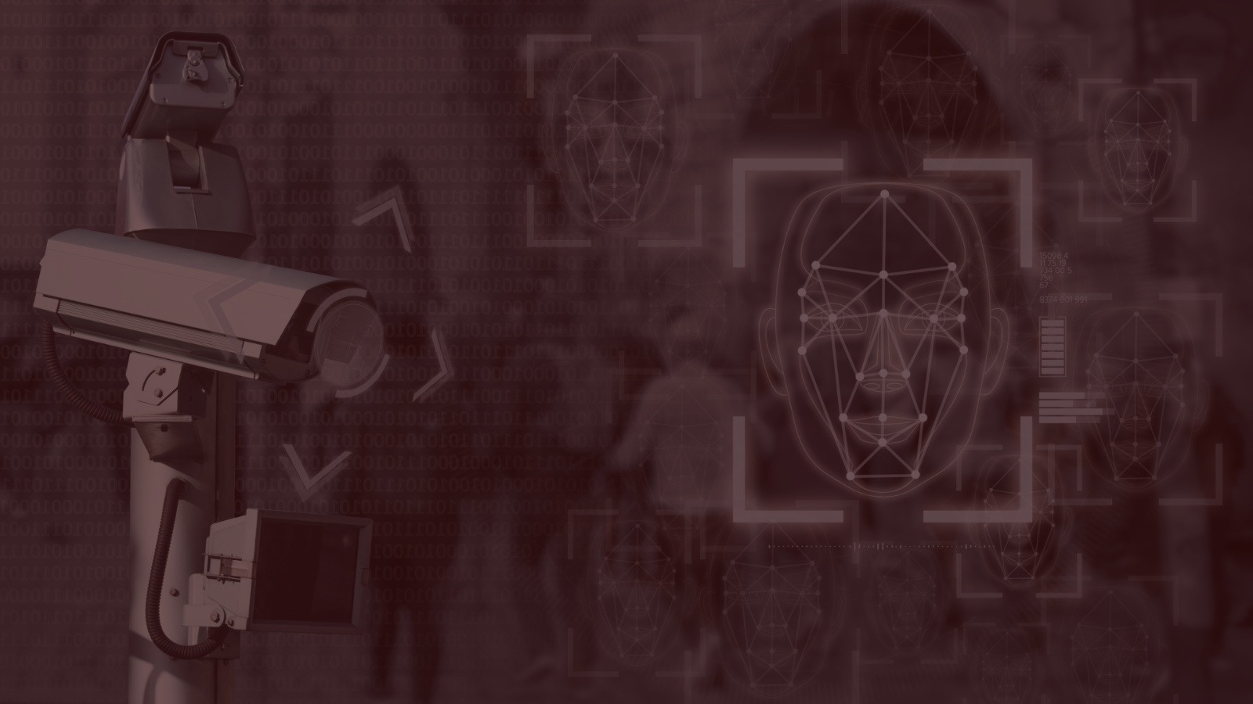

FACEFINDR.
YOUR VISION, OUR INNOVATION,
EVERY MOMENT CAPTURED!
MILESTONE 1
PECI 2023/24
GROUP 3
Alexandre Martins
Bruno Gomes
Daniel Frank
Diogo Silva
João Gonçalves
Miguel Marques

Slide 2




CONTEXT
With so many multi-person events these days, there is a desire for attendees to look for their photos, if they exist, without having to see all the ones there are.

Slide 3


PROBLEM
With the large number of photos and people in those photos, it is difficult for photographers to document the people present at these events, as well as for the people present at these events, to find their photos.

Slide 4


GOAL
Develop a WebApp using facial recognition and image processing to locate people in photos of large meetings and improve photo quality.

Slide 5


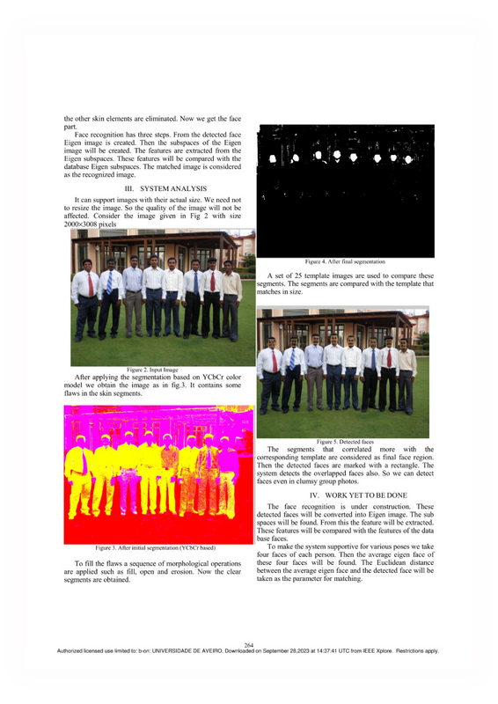

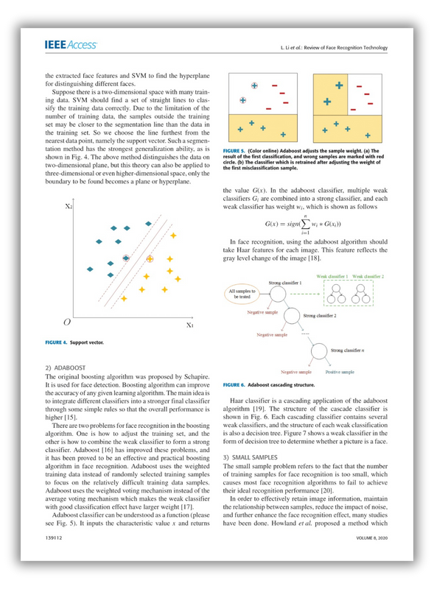
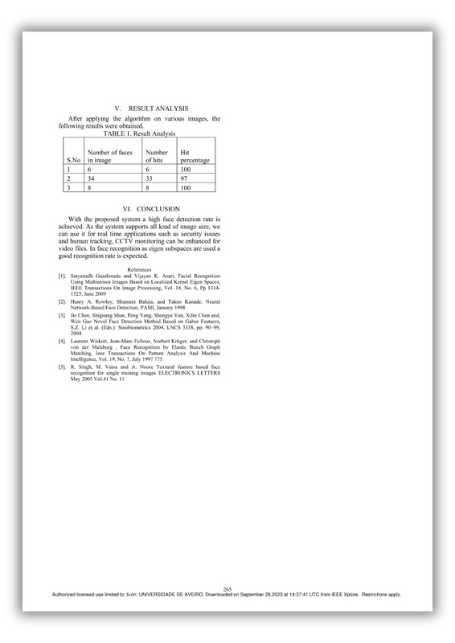
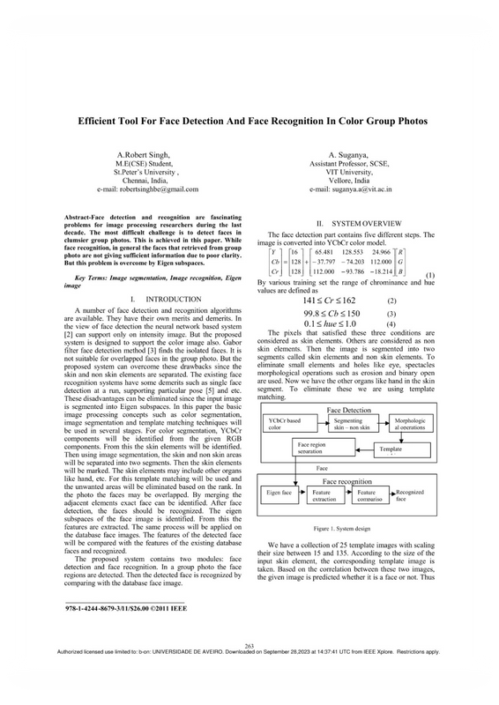
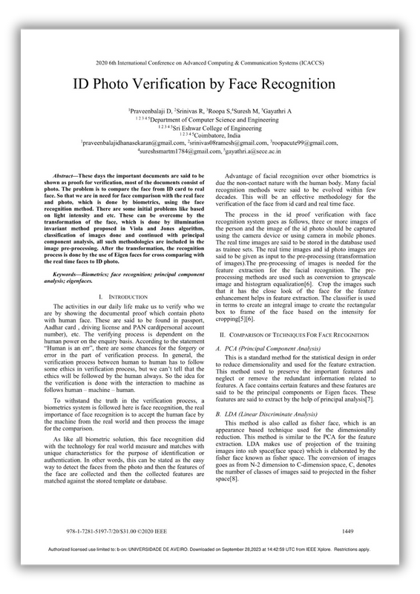
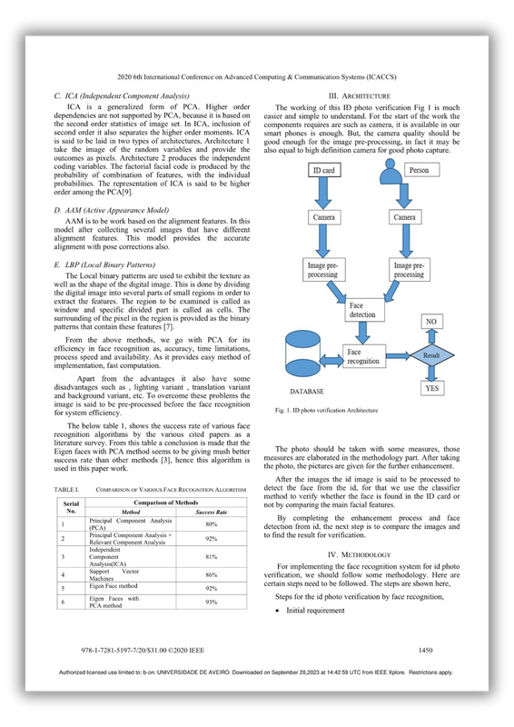
SCOPE & RELATED WORK
A survey of face detection algorithms
Ankit Srivastava,Suraj Mane, Aaditya Shah, Nirmit Shrivastava, Prof. Bhushan Thakare Computer Department Sinhgad Academy Of Engineering · 2017
Face Recognition and Identification using Deep Learning Approach
Teoh, K. H., Ismail, R. C., Naziri, S. Z.M., Hussin, R., Isa, M. N.M., Basir, M. S.S.M.,
Journal of Physics: Conference Series · 1755 (2021)
Digital Image Processing, 4th edition
Rafael C. Gonzalez, Richard Eugene Woods · 2018

Slide 6








TASKS
Review related work
Website
Facedetection and recognition
Tools to edit photos
To be defined
Focus Group & Use Cases
Define
architecture
Get ahold of previous research
Requirements Extraction
Write report’s related section
Identify scenery in the photos
Tools for depth perception
Photo matching
M1: STATE OF THE ART
M2: REQUIREMENTS & ARCHITECTURE
DEVELOPEMENT
DOCUMENTATION

Slide 7
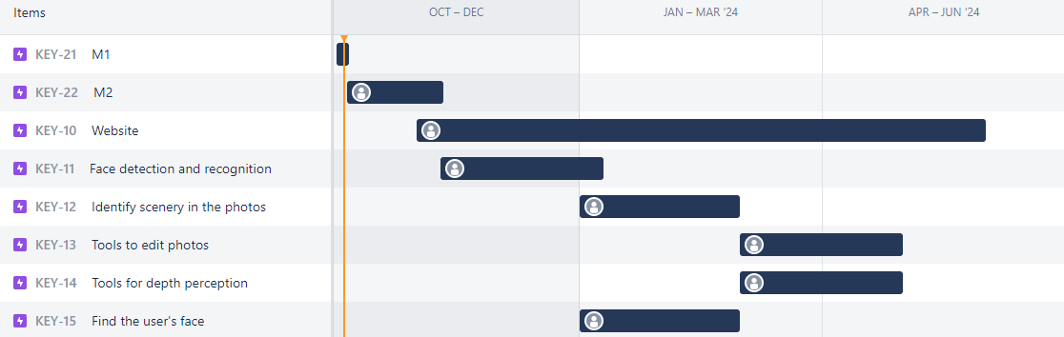
WORKPLAN

Slide 8





EXPECTED RESULTS
Allow photographers to upload photos of people in large events
Allow photographers to label the photos with context information about the scene and the people
Use computer vision techniques to identify people in the photos
Provide photographers with tools to estimate the depth of the people in the photos, for querying purposes
Provide photographers with tools to enhance the photos

Slide 9





COMMUNICATION PLAN
GITHUB
JIRA
DISCORD
MENDELEY

Slide 10

ANY
QUESTIONS?

Slide 11
FACEFINDR.
YOUR VISION, OUR INNOVATION,
EVERY MOMENT CAPTURED!

